Slide 1

Rational Rose (version 2002)
“The World's Leading Visual Modelling Tool”

Slide 2
4+1 View of Software Architecture
Software architecture consists of 5 concurrent views .
Rational Rose provides 5 different perspectives/views.
Selecting a view allows users to focus only on what is architectural significant and meaningful to them

Slide 3
View Target Audience:
  Use-Case View End User
  Logical View Analyst/Designer
  Process View System Integrator
  Deployment View System Engineer
  Implementation View Programmer

Slide 4
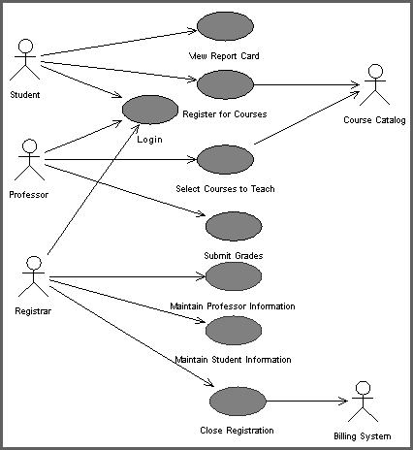
The Use-Case View
From end-users' perspective
Concerned with
  Understandability
  Communication
  Usability
Use Case Model
captures system's intended functions and interactions with environment
  use case diagrams
  use case flow of events
  supplemental documentation
  activity diagrams (optional)
requirements specification.
Use Case Model can serve as a contract between customer and developer instead of the traditional text requirement specification
A Use Case Diagram

Slide 5
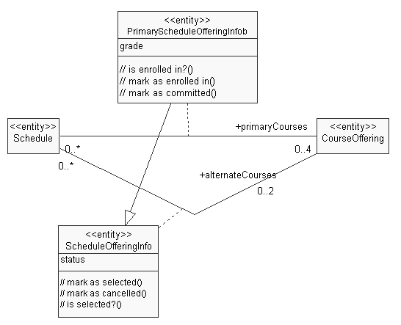
The Logical View
Concerned with functional requirements of the systems
From analyst/designer perspective
Includes
  use case realization diagrams
  class diagrams
  interaction diagrams
  statechart diagrams (optional)
  activity diagrams (optional)
A Class Diagram

Slide 6
The Process View
Presents a perspective for the System Integrators
Non-functional requirements
Include:
  Performance
  Scalability
  Availability
  Fault Tolerance
  Throughput
  Concurrency and synchronization
    threads
    processes
    Note: Not necessarily a single processing environment

Slide 7
The Implementation View
Called Component View in Rational Rose
Aimed at Programmers
Captures organization of static software modules:
  packaging, layering, and configuration management
    source code files
    data files
    components
    executable, etc.
Concerned with derived requirements:
  ease of development
  software management
  reuse
  constraints imposed by programming language and development tools
  sub-contracting

Slide 8
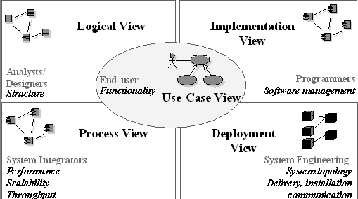
4 Views + 1 Architectural View
in Rose: Component View

Slide 9

Rational Rose diagrams in UML
Requirements Views
Use Case
Deployment
Class
Physical Views
Logical Views
Component
Object
Activity
Collaboration
State
Sequence
Dynamic Views

Slide 10
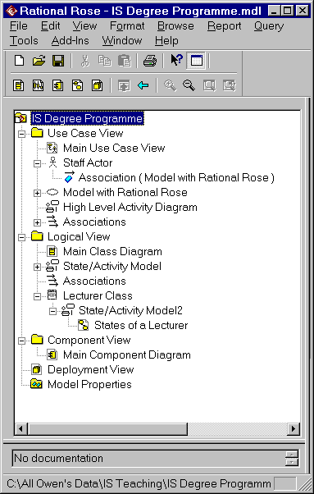
Rational Rose diagrams in UML
Use Cases plus Dynamic Views
Requirements Views
Use Case
Deployment
Class
Physical Views
Logical Views
Component
Object
Activity
Collaboration
State
Sequence
Dynamic Views
Logical plus Dynamic Views

Slide 11
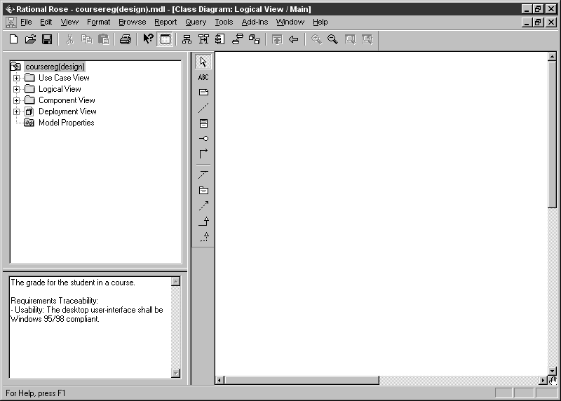
Rational Rose Environment
Standard menu
Standard toolbar
Diagram toolbar (unique to each type of diagram)
Diagram window
Browser window
(used to organize and navigate)
Can be hidden, docked or floating
Status bar
Documentation
window

Slide 12
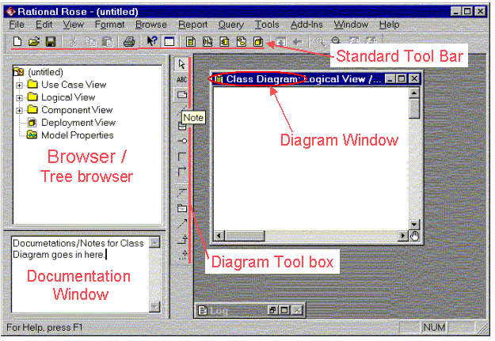

Slide 13
The Documentation Window
Used to create, view and modify text documenting a selected item.
May be visible or hidden; docked or floating
  can be changed
    by selecting using View menu or
    right clicking on an item in the Documentation Window
The information added to the documentation window automatically updates the Documentation field in the appropriate specification.

Slide 14
The Diagram Window
Allows you to create, update, and modify graphical views of the current model.
The Diagram Toolbox is unique to the diagram type, and changes automatically when you change types of diagrams.
Select a diagram or add a diagram by selecting it from those listed under the appropriate view in the Browser Window

Slide 15
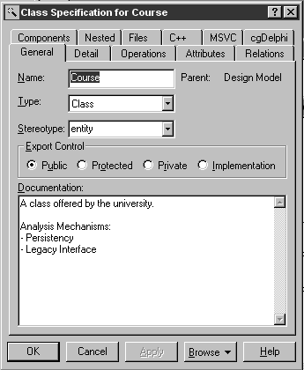
The Specification Window
Textual representation of a model element that permits viewing and manipulating the element's model properties
Open by right clicking on a View in the Browser Window

Slide 16
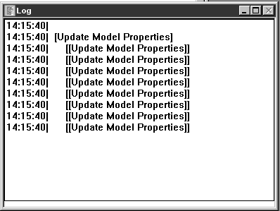
The Log Window
Reports
  progress
  results
  errors
Right click in the Log Window to set available action
Ctrl-tab from Log Windows returns to previous diagram

Slide 17
Developing the Use Case Diagrams
USE CASE DIAGRAMS
In the Inception Phase
  Identify actors
  Identify principal use cases
In the Elaboration Phase
  More detailed information is added
    associations
    stereotypes
  Additional use cases are added as needed

Slide 18
USE-CASE DIAGRAM :
Use-case diagrams graphically represents system behavior (use cases). These diagrams present a high level view of how the system is used as viewed from an outsider’s (actor’s) perspective. A use-case diagram may contain all or some of the use cases of a system.
A use-case diagram can contain:
·actors ("things" outside the system)
·use cases (system boundaries identifying what the system should do)
interactions or relationships between actors and use cases in the system including the associations, dependencies, and generalizations.
Use-case diagrams can be used during analysis to capture the system requirements and to understand how the system should work. During the design phase, you can use use-case diagrams to specify the behavior of the system as implemented.

Slide 19
Finding Actors
Actors are NOT part of the system.
Actors represent anyone or anything that interacts with (input to or receive output from) the system.
An actor is someone or something that:
· Interacts with or uses the system
· Provides input to and receives information from the system
· Is external to the system and has no control over the use cases
Actors are discovered by examining:
· Who directly uses the system
· Who is responsible for maintaining the system
· External hardware used by the system
· Other systems that need to interact with the system
The needs of the actor are used to develop use cases. This insures that the system will be what the user expected.

Slide 20
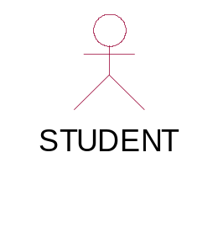
Graphical Depiction
An actor is a stereotype of a class and is depicted as a "stickman" on a use-case diagram.
Naming
The name of the actor is displayed below the icon.

Slide 21
Questions to help to identify actors
Who is interested in a certain requirement
Where is the system used within the organization?
Who will benefit from the use of the system?
Who will supply the system with information, use this information, and remove this information?
Who will support and maintain the system?
Does the system use an external resource?
Does one person play several different roles?
Do several people play the same role?
Does the system interact with a legacy system?

Slide 22
Finding Use Cases
Use case is a sequence of transactions performed by a system that yields a measurable result of values for a particular actor
The use cases are all the ways the system may be used.
Graphical Depiction
The basic shape of a use case is an ellipse:
Naming
A use case may have a name, although it is typically not a simple name. It is often written as an informal text description of the actors and the sequences of events between objects. Use case names often start with a verb. For example, names of possible use cases for an ATM machine might include Dispense Cash or Transfer Funds.
The name of the use case is displayed below the icon.
Transfer Funds

Slide 23
Questions to help find use cases
What are the tasks of each actor?
Will any actor create, store, change, remove or read information in the system?
What use cases will create, store, change, remove, or read this information?
Will any actor need to inform the system about sudden, external changes?
Does any actor need to be informed about certain occurrences in the system?
What use cases will support or maintain the system?
Can all functional requirements be performed by the use cases?

Slide 24
Relations :
Association Relationship :
An association provides a pathway for communication. The communication can be between use cases, actors, classes or interfaces. Associations are the most general of all relationships and consequentially the most semantically weak. If two objects are usually considered independently, the relationship is an association
By default, the association tool on the toolbox is uni-directional and drawn on a diagram with a single arrow at one end of the association. The end with the arrow indicates who or what is receiving the communication.
bi-directional association :
If you prefer, you can also customize the toolbox to include the bi-directional tool to the use-case toolbox.

Slide 25
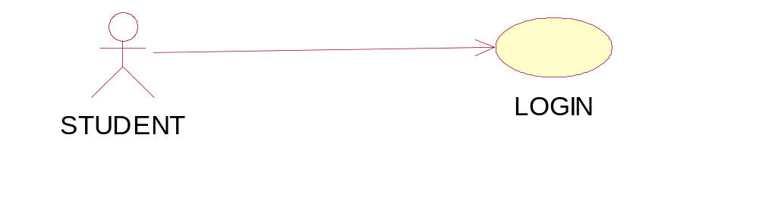
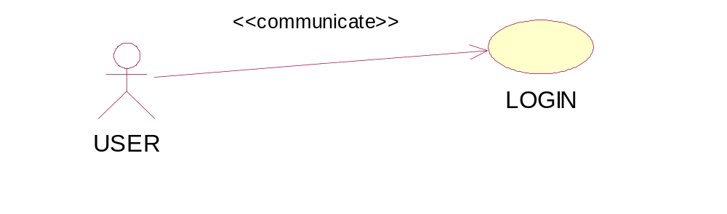
Graphical Depiction
An association relationship is an orthogonal or straight solid line with an arrow at one end:
In An ASSOCIATION Relationship, we can provide Stereotype COMMUNICATE also as shown below

Slide 26
Dependency Relationship :
A dependency is a relationship between two model elements in which a change to one model element will affect the other model element. Use a dependency relationship to connect model elements with the same level of meaning. Typically, on class diagrams, a dependency relationship indicates that the operations of the client invoke operations of the supplier.
We can provide here
1.Include Relationship.
2.Extend Relationship

Slide 27
There are two types of dependency relationships that may exist between use cases: include relationship and extend relationship.
Multiple use cases may share pieces of the same functionality. This functionality is placed in a separate use case rather than documenting it in every use case that needs it

Slide 28
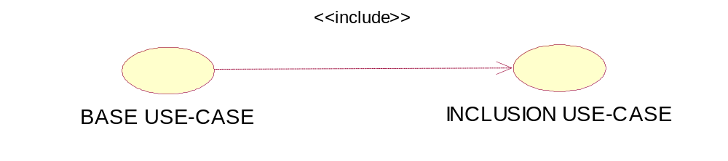
An include relationship is used to show
Include relationships are created between the new use case and any other use case that "uses" its functionality.
An include relationship is a stereotyped relationship that connects a base use case to an inclusion use case. An include relationship specifies how behavior in the inclusion use case is used by the base use case.

Slide 29
Extend Relationship
An extend relationship is a stereotyped relationship that specifies how the functionality of one use case can be inserted into the functionality of another use case. Extend relationships between use cases are modeled as dependencies by using the Extend stereotype.
An extend relationship is used to show
Optional behavior
Behavior that is run only under certain conditions such as triggering an alarm
Several different flows that may be run based on actor selection
An extend relationship is drawn as a dependency relationship that points from the extension to the base use case

Slide 30
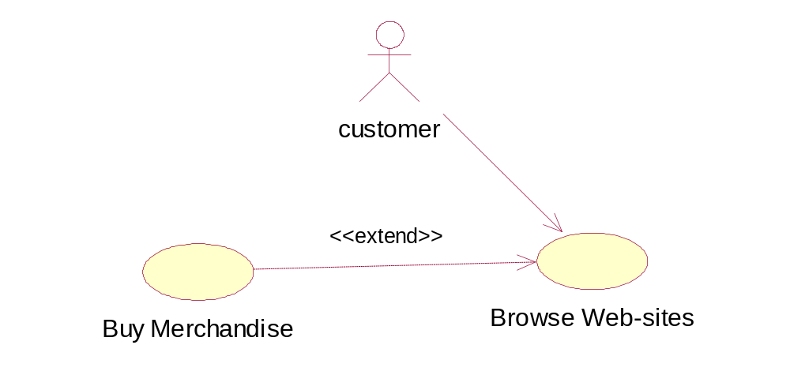
The extend relationship sample demonstrates how you can use an extend relationship to connect use cases. The sample illustrates two important aspects of extend relationships:
· An extend relationship shows optional functionality or system behavior.
· A base use case does not need to acknowledge any specific extended use cases
The sample below shows a diagram containing an actor interacting with a web site. The Customer has the option of buying merchandise online as shown through the extend relationship.

Slide 31
«extend» is used when you wish to show that a use case provides additional functionality that may be required in another use case.
«include» applies when there is a sequence of behaviour that is used frequently in a number of use cases, and you want to avoid copying the same description of it into each use case in which it is used.

Slide 32
ESU COURSE REGISTRATION PROBLEM STATEMENT
AT THE BEGINNING of each semester, students may request a course catalog containing a list of course offerings for the semester. Infor­mation about each course, such as professor, department, and prerequisites will be included to help students make informed decisions.
The new system will allow students to select four course offerings for the coming semester. In addition, each student will indicate two alternative choices in case a course offering becomes filled or canceled. No course offering will have more than ten stu­dents or fewer than three students. A course offering with fewer than three students will be canceled. Once the registration process is completed for a student, the registration system sends information to the billing system so the student can be billed for the semester.
Professors must be able to access the online system to indicate which courses they will be teaching, and to see which students signed up for their course offerings.
For each semester, there is a period of time that students can change their schedule. Students must be able to access the system during this time to add or drop courses.

Slide 33
Actors in the ESU Course Registration System Students want to register for courses
Professors want to select courses to teach
The Registrar must create the curriculum and generate a catalog for the semester
The Registrar must maintain all the information about courses, professors, and students
The Billing System must receive billing information from the system .
Based on the answers to the questions posed, the following actors have been identified: Student, Professor, Registrar, and the Billing System.

Slide 34
USE-CASES in ESU Course Registration System :
Use Cases in the ESU Course Registration System The following needs must be addressed by the system:
The Student actor needs to use the system to register for courses.
After the course selection process is completed, the Billing System must be supplied with billing information.
The Professor actor needs to use the system to select the courses to teach for a semester, and must be able to receive a course roster from the system.
The Registrar is responsible for the generation of the course catalog for a semester, and for the maintenance of all information about the curriculum, the students, and the professors needed by the system.
Based on these needs, the following use cases have been identified:
Register for courses
Select courses to teach
Request course roster
Maintain course information
Maintain professor information
Maintain student information
Create course catalog

Slide 35
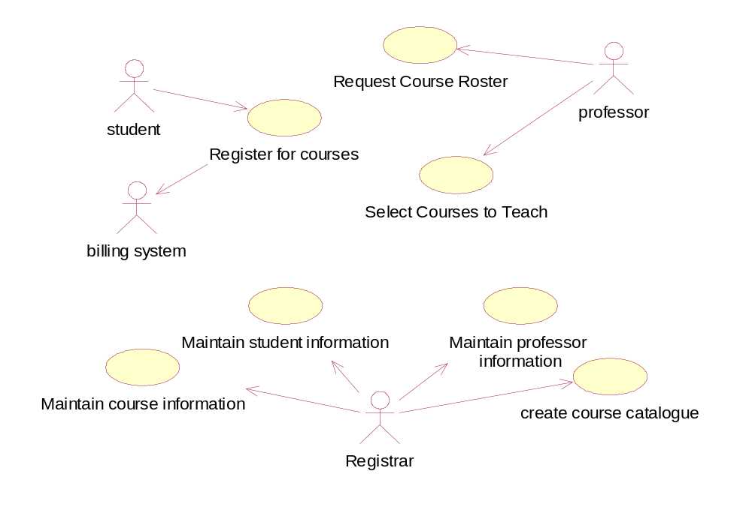
MAIN USE CASE DIAGRAM FOR ESU :

Slide 36
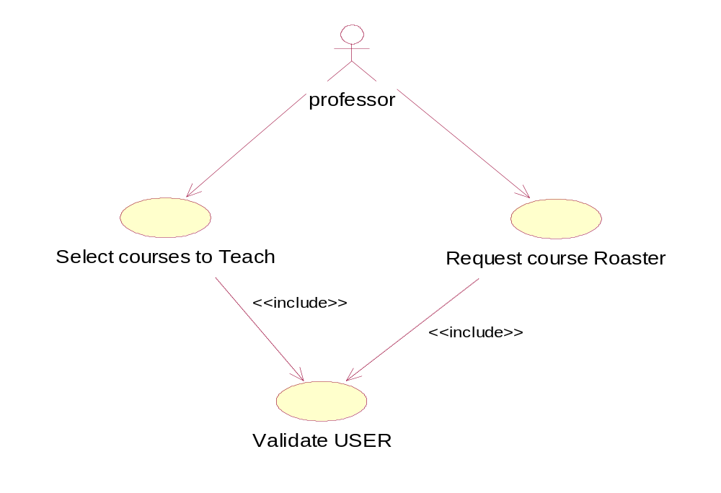
ADDITIONAL USE CASE DIAGRAM

Slide 37
Finding Flow of Events
Flow of events document is typically created in the elaboration phase
Each use case is documented with flow of events
  a description of events needed to accomplish required behavior
  written in terms of what the system should do, NOT how it should do it
  written in the domain language, not in terms of the implementation
Flow of events should include
  When and how the use case starts and ends
  What interaction the use case has with the actors
  What data is needed by the use case
  The normal sequence of events for the use case
  The description of any alternate or exceptional flows

Slide 38
The flow of events for a use case is contained in a document called the Use Case Specification. Each project should use a stan­dard template for the creation of the Use Case Specification. Includes the following
1.Use case name , Brief Description
2.Flow of Events - 1.Basic flow.
2.Alternative flow.
3.Special requirements.
4. Pre conditions.
5. Post conditions.
6. extension points.
Linking this document with use case :Right Click on to the Use case in Browser window, select file and attach desired file to the use case.

